Slide 1
帳單Draft API

Slide 2
產製帳單Draft
Method: POST
URL: http://localhost:8000/api/v1/getBillMasterDraftStream
POST Body:
{
"BillMasterID": 1,
"UserI": "username",
}

Slide 3
{
"ContactWindowAndSupervisorInformation": {
"Company": "中華電信",
"Address": "testaddr",
"Tel": "02-23443897",
"Fax": "02-23443897",
"DirectorName": "郭贊章",
"DTel": "testtel",
"DFax": "testfax"
},
"PartyInformation": {
"Company": "Chunghwa Telecom Co., Ltd. Network Technology Group",
"Address": "31, Aikuo East Road, Taipei, Taiwan 106",
"Contact": "黃宏杰",
"Email": "hj-hwang@cht.com.tw",
"Tel": "03-9772252"
},
"CorporateInformation": {
"BankName": "Bank of Taiwan, Hsinyi Branch",
"Branch": "",
"BranchAddress": "31 Aikuo E. Rd., Taipei, Taiwan, 106",
"BankAcctName": "SJC2 Central Billing Party of Chunghwa Telecom (International Business Group)",
"BankAcctNo": "054007501968",
"SavingAcctNo": "",
"IBAN": "",
"SWIFTCode": "BKTWTWTP054",
"ACHNo": "",
"WireRouting": "",
"Address": "88, Sec. 2, Sinyi Road, Taipei"
},
"DetailInformation": [
{
"Supplier": "NEC Corporation, Submarine Network Division",
"InvNumber": "02CO-CI2303301838",
"Description": "BM9a Sea cable manufactured (except 8.5km spare cable))- Equipment",
"AmountBilled": 1288822.32,
"Liability": 7.1428571429,
"YourShare": 92058.74
},
{
"Supplier": "NEC Corporation, Submarine Network Division",
"InvNumber": "02CO-CI2303301838",
"Description": "BM9a Sea cable manufactured (except 8.5km spare cable))- Service",
"AmountBilled": 1178227.94,
"Liability": 7.1428571429,
"YourShare": 84159.14
},
{...}
],
"InvoiceNo": "02CO-CI2303301838"
}
帳單產製輸入畫面資訊
分類 | 輸入介面顯示 | 對應帳單顯示 | 資料產生方式來源
聯絡窗口與主管資訊 | 窗口人員 | 公司名稱(左下英文) | 使用者從使用者資料表選取擔任窗口的使用者，這些資訊會被全部帶出 使用者選取
聯絡窗口與主管資訊 |  | 公司地址(右上英文) | 以當下使用者帳號查使用者資料表帶出
 |  | 窗口連絡電話(右上Tel) | 使用者選取
 |  | 窗口傳真電話(右上Fax) | 使用者選取
 |  | 主管姓名(左下英文) | 以當下使用者帳號查使用者資料表帶出
 |  | 主管連絡電話(左下Tel) | 以當下使用者帳號查使用者資料表帶出
 |  | 主管傳真電話(左下Fax) | 以當下使用者帳號查使用者資料表帶出
會員資訊 | 會員名稱 | 公司名稱(左中英文) | 以當下會員名稱查會員資料表，這些資訊會被全部帶出
 |  | 公司地址(左中英文)
 |  | 連絡窗口(左中英文)
 |  | Email(左中英文)
 |  | 連絡電話(左中Tel)
帳單標題 | 前-海纜名稱 | 標題(前) | 使用者自行key in
 | 中-計帳段號 | 標題(中)
 | 後-帳單種類 | 標題(後)
帳單資訊 | 帳單開立日 | IssueDate | 使用者自行key in/選擇日期
 | 帳單到期日 | DueDate
聯盟資訊 | 海纜名稱 | Bank Name | 以當下海纜名稱查聯盟資料表，這些資訊會被全部帶出
 |  | Branch Name
 |  | Branch Address
 |  | A/C Name
 |  | AC No.
 |  | Saving Account No
 |  | IBAN
 |  | Swift
 |  | ACH
 |  | Wire/Routing

Slide 4
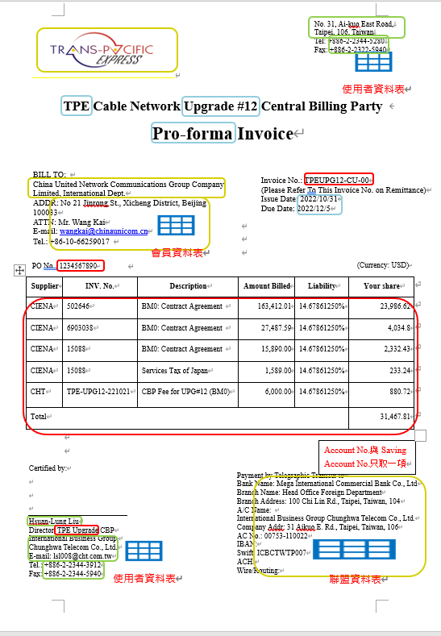
{
"ContactWindowAndSupervisorInformation": {
"Company": "中華電信",
"Address": "testaddr",
"Tel": "02-23443897",
"Fax": "02-23443897",
"DirectorName": "郭贊章",
"DTel": "testtel",
"DFax": "testfax"
},
"PartyInformation": {
"Company": "Chunghwa Telecom Co., Ltd. Network Technology Group",
"Address": "31, Aikuo East Road, Taipei, Taiwan 106",
"Contact": "黃宏杰",
"Email": "hj-hwang@cht.com.tw",
"Tel": "03-9772252"
},
"CorporateInformation": {
"BankName": "Bank of Taiwan, Hsinyi Branch",
"Branch": "",
"BranchAddress": "31 Aikuo E. Rd., Taipei, Taiwan, 106",
"BankAcctName": "SJC2 Central Billing Party of Chunghwa Telecom (International Business Group)",
"BankAcctNo": "054007501968",
"SavingAcctNo": "",
"IBAN": "",
"SWIFTCode": "BKTWTWTP054",
"ACHNo": "",
"WireRouting": "",
"Address": "88, Sec. 2, Sinyi Road, Taipei"
},
"DetailInformation": [
{
"Supplier": "NEC Corporation, Submarine Network Division",
"InvNumber": "02CO-CI2303301838",
"Description": "BM9a Sea cable manufactured (except 8.5km spare cable))- Equipment",
"AmountBilled": 1288822.32,
"Liability": 7.1428571429,
"YourShare": 92058.74
},
{
"Supplier": "NEC Corporation, Submarine Network Division",
"InvNumber": "02CO-CI2303301838",
"Description": "BM9a Sea cable manufactured (except 8.5km spare cable))- Service",
"AmountBilled": 1178227.94,
"Liability": 7.1428571429,
"YourShare": 84159.14
},
{...}
],
"InvoiceNo": "02CO-CI2303301838"
}

